Slide 1
Input Impedance

Slide 2
Consider a transmission line of length ℓ characterized by ϒ and Z₀ ,connected to a load Z_{L} as shown in Figure:
Looking into the line, the generator sees the line with the load as an input impedance Zin

Slide 3
Our intention in this section to determine the input impedance:
Let the transmission line extend from z = 0 at the generator to z = ℓ at the load, means the total length of transmission line is ℓ.

Slide 4


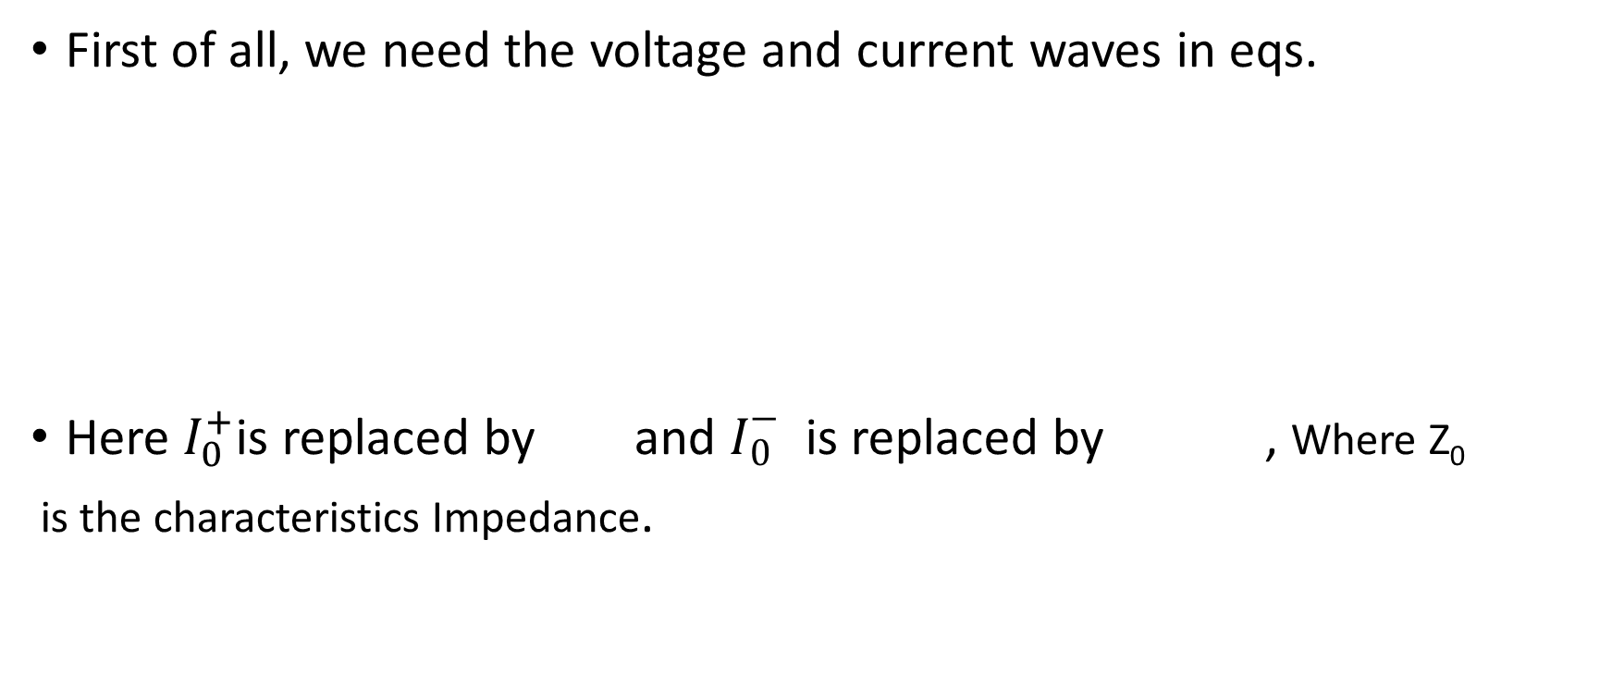
First of all, we need the voltage and current waves in eqs.
Here $I_{0}^{+}$is replaced by and $I_{0}^{−}$ is replaced by , Where Z₀
is the characteristics Impedance.

Slide 5
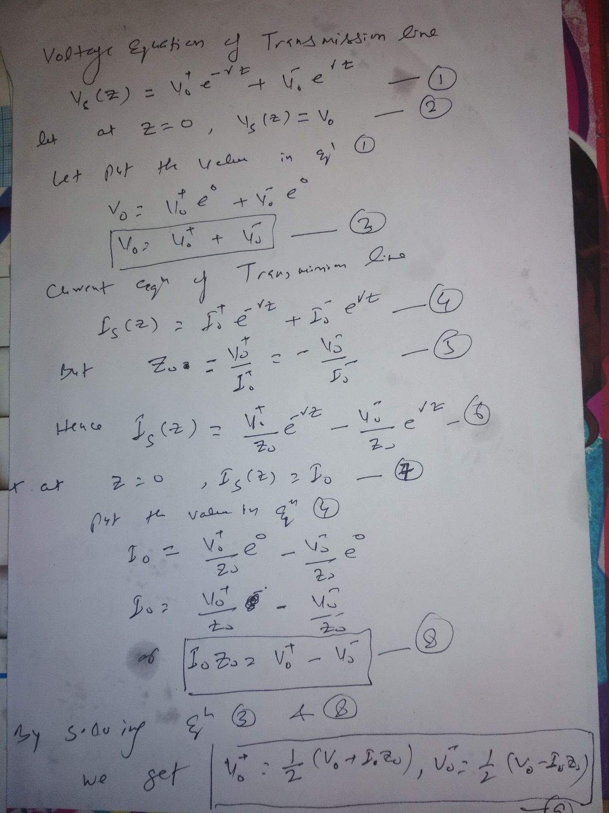

Slide 6
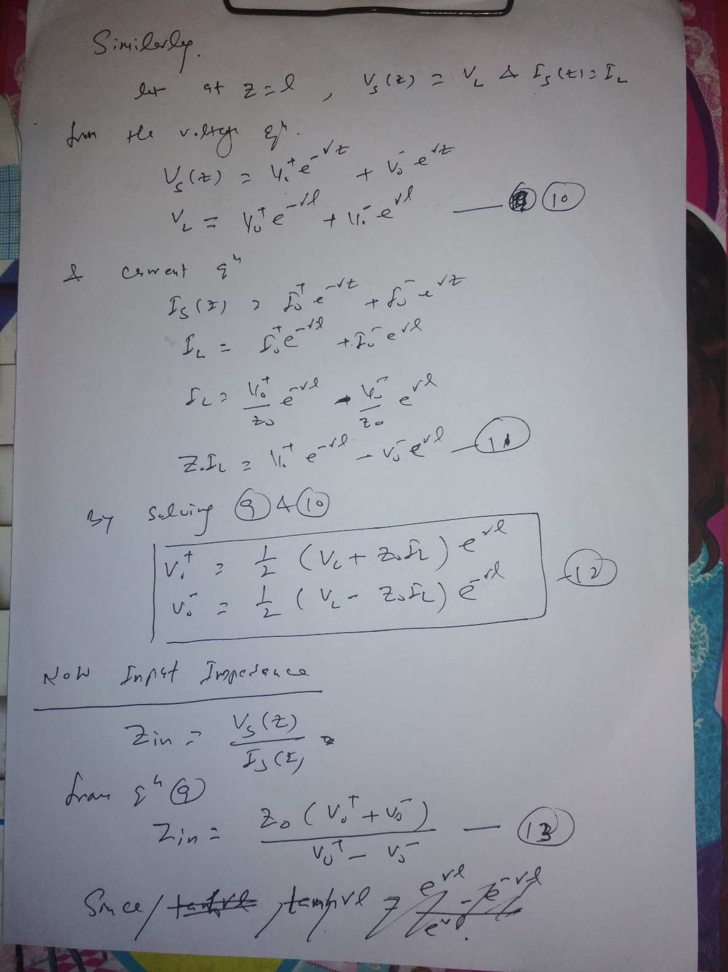

Slide 7
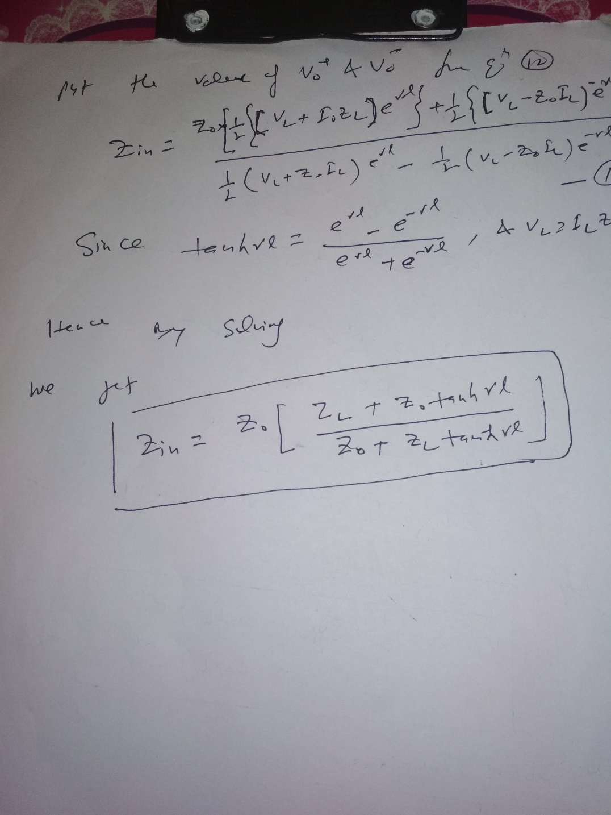
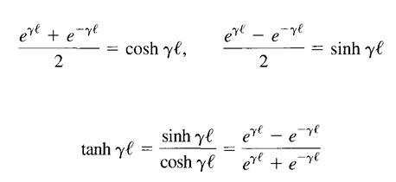

Slide 8
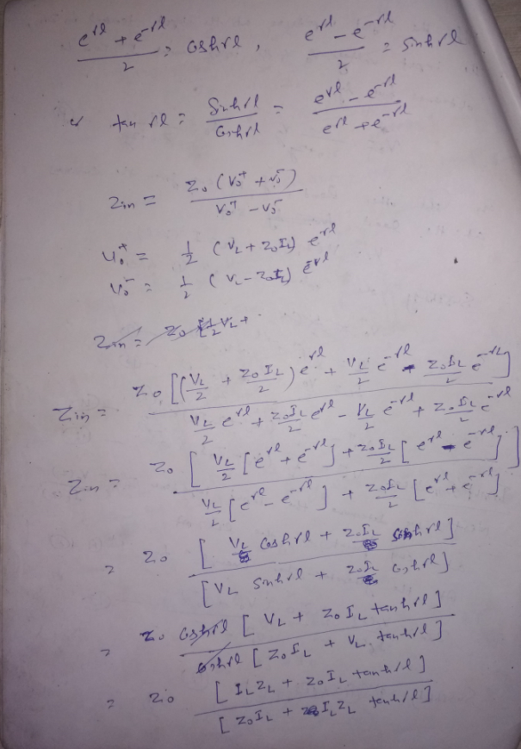

Slide 9
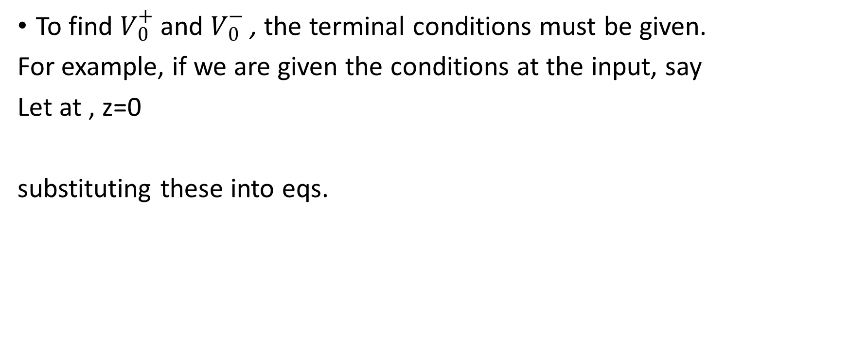
To find $V_{0}^{+}$and $V_{0}^{−}$, the terminal conditions must be given.
For example, if we are given the conditions at the input, say
Let at , z=0
substituting these into eqs.

Slide 10

On the other hand, if we are given the conditions at the load, say
Let at Z=l

Slide 11
Next, we determine the input impedance

